Slide 1
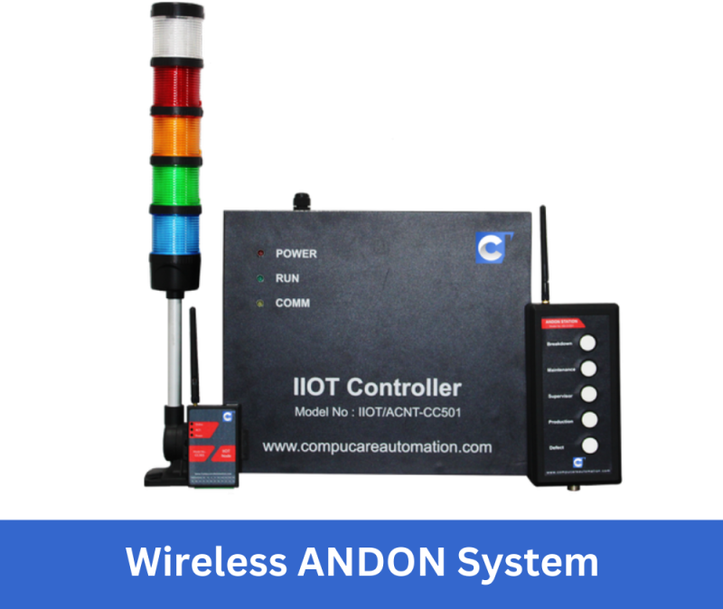
WIRELESS ANDON SYSTEM

Slide 2
ANDON SYSTEM OVERVIEW: -
Andon system in lean manufacturing refers to the alert mechanism from the operator to the maintenance person. Andon is a Japanese word translated as “lantern” or “light”.
Types of Andon system: -
Manual
Automatic
Manual Andon System: -
The manual type of andon refers to a cord or rope attached over the ceiling above assembly line, when pulled it notifies the operator about the problem. This method increases the efficiency and allows the operator to find the problematic station quickly. When the cord is pulled, it notifies the operator using light above the machine and the production is stopped.
Automatic Andon System: -
This type of system automatically notifies the operator about the problem without any human intervention. Components like controllers, sensors etc., are connected internally to the system to detect the problem. This works on a built-in logic within the operating machines.
Notes:
ANDON SYSTEM OVERVIEW: -

Slide 3
Types of Automatic Andon System: -
Visual Andon system
Audio Andon system
Digital Andon system
Hybrid Andon system
Jidoka Andon system
Wireless Andon system

Slide 4
Wireless Andon System: -
Our idea is to build an Andon system which will communicate from a far place to the maintenance room wirelessly. To achieve this, we will be using wireless communication system such as Wi-Fi, Bluetooth, RF transmission, Zigbee etc.,. In our system we will be using Wi-Fi for communication because the range of Wi-Fi is longer than other devices.
Components used: -
ESP8266 NodeMcu (Wi-Fi) x 2
Led’s x 6
Push button switches x 3
Breadboard
Jumper wires

Slide 5
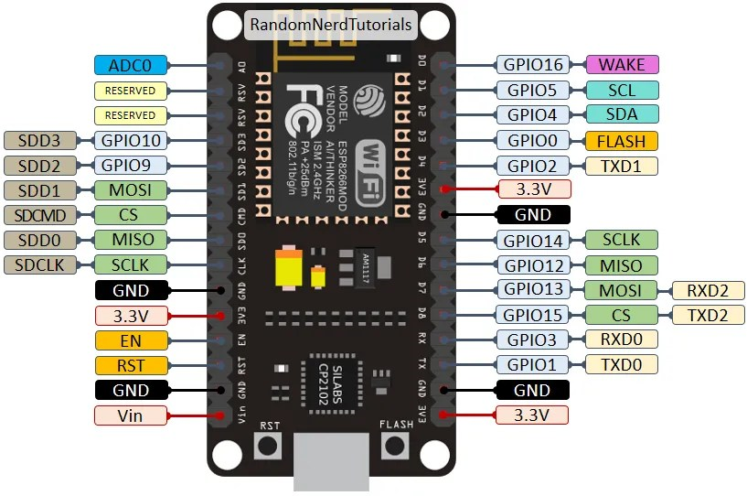
ESP8266 NodeMcu (Wi-Fi): -
Esp8266 is a low-cost built-in Wi-Fi microcontroller. It has built-in ADC pin which is used for converting signal from analog to digital.
Features of ESP8266:-
32 kB RAM
32-bit microcontroller
4kB flash memory
160 MHz frequency
Built-in Wi-Fi
17 GPIO Pins
Built-in UART pins
10-bit ADC
Notes:
Esp8266 is a low-cost built-in Wi-Fi microcontroller. It has built-in ADC pin which is used for converting signal from analog to digital.

Slide 6
Working: -
We will be using 2 ESP8266 microcontroller. One acts as receiver and the other acts as transmitter.
Receiver Microcontroller:-
This controller is setup in the maintenance room. This controller connects to the local Wi-Fi network and creates a local IP address of the controller. It creates a web server on port 80 for communication. 3 led are connected to the controller on the pins D1, D2 & D3. It receives the state of the button sent from the transmitter controller and indicate through corresponding led.
Transmitter Microcontroller:-
This controller is setup in the production area. This controller connects to the Wi-Fi network and to the receiver IP address to connect to the web server of the receiver microcontroller. It also create a web server on port 80. 3 push button switches connected to the pins D1, D2, D3 and 3 led on the pins D4, D5 & D6. When we push any of the buttons, the corresponding led turns on and the button state of that button is sent to receiver controller through Wi-Fi and web server.
Notes:
Working: -

Slide 7
Both the controller should connect to same Wi-Fi network to transmit and receive the data. Antenna in the controller is responsible for wireless communication. If the range is to be increased, we should replace the antenna with a different one with higher gain antenna. Directional antennas like Yagi or parabolic antennas can focus the signal in a specific direction, increasing the range in that direction.
Both the controllers should have the same port number to create and connect to web server. If not, the controller will not connect to each other
Below link for codes: -
https://github.com/Guru08prasad/Wireless-Andon-System-
Notes:
hhhhh

Slide 8
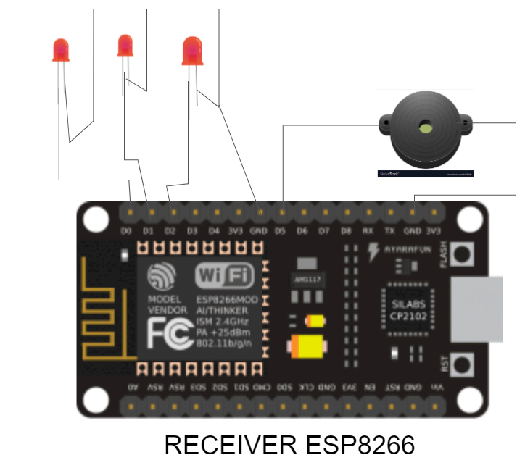
Circuit Diagram: -
Notes:
Circuit Diagram: -

Slide 9
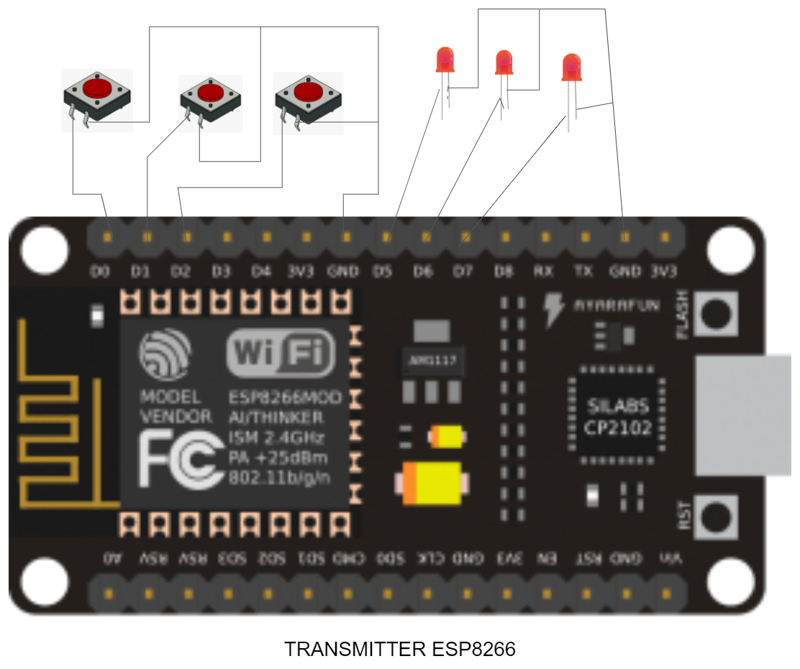
Circuit Diagram: -

